Slide 1
Scenarios in HCI
Ms. Iqra Shahzad
Department of Software Engineering ,NUML Islamabad.

Slide 2
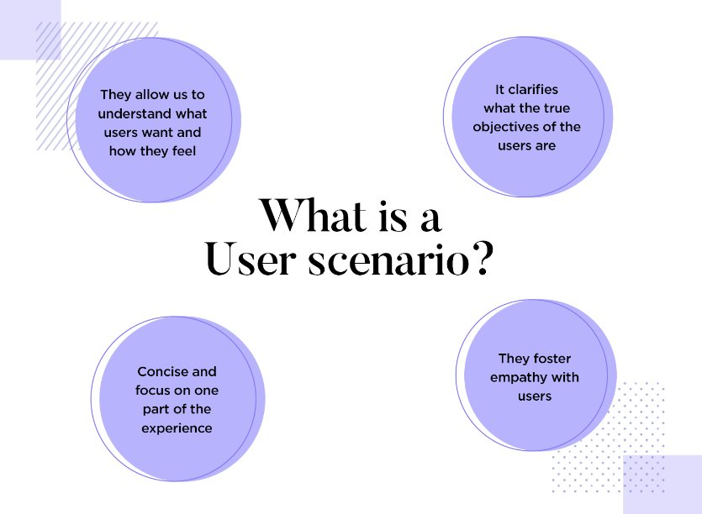
Introduction
Scenarios are stories that describe how your user personas interact with your product or system in specific situations, such as completing a task, solving a problem, or achieving a goal.
User scenarios are detailed descriptions of a user – typically a persona – that describe realistic situations relevant to the design of a solution.

Slide 3
DEVELOPING SCENARIOS
By painting a “rich picture” of a set of events, teams can appreciate user interactions in context, helping them to understand the practical needs and behaviours of users.
User personas and scenarios are powerful tools for human-computer interaction (HCI) design and evaluation. They help you understand and empathize with your target users, their goals, needs, and contexts.
Help you communicate and collaborate with your stakeholders, such as clients, developers, and testers, by providing a common language and reference point.
By using them to explain and justify design decisions and trade-offs based on the user's needs and goals, you can share and align your vision with your stakeholders, as well as provide clear specifications for developers.

Slide 4
What does a user scenario look like?
Characteristic of user scenarios is that they give us a bit of context related to the user and how they would come to use the product. They tend to include a bit of a story that could include something like this:
“Samantha is a student who has an important exam next week. She needs to find a platform that helps her manage her time between studying for the test and her other assignments for school, to reach her goal of passing all classes.”
A small observation: It’s unwise to try to create user scenarios that portray all users. Instead, be specific and base yourself on one user persona per user scenario. Check out our post on user persona templates for more details.

Slide 5
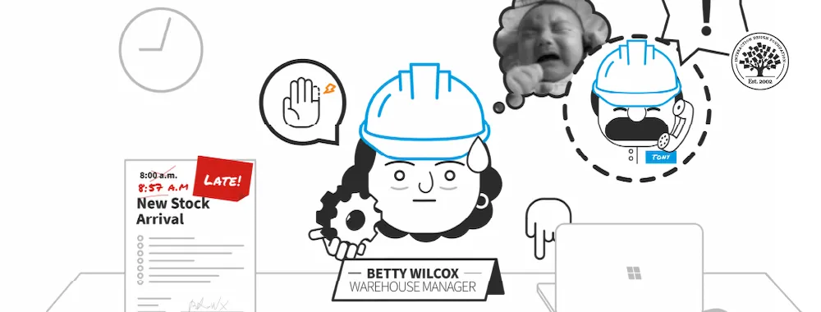
usually textual, user scenarios paint a “rich picture” of important factors behind users’ needs and behaviors.

Slide 6
Creating scenarios
Explore and explain motivations for certain user needs and behaviors.
Explicitly describe how our persona expects interactions to proceed, with expectations about the sequence of events, the formats of input and output and details of the information required to realize this scenario effectively.
Draw attention to “pain points” in an existing process or anticipated complexity in new processes.

Slide 7
...
Who the user is
The situation that drives users to seek the product
A specific task or goal the user has
Information regarding user’s income and spending
The path to completion of a task
Points of friction or stress in daily life or in the user experience

Slide 8
User scenario examples
Supply management user scenario example
This is another rather complete user scenario from our friends at IDF. It perfectly captures the real-life struggles that motivate the user to seek a solution – as well as the main benefit he would get from it.
“Jeremy, 52, a senior manager for a medical supplies company, needs constantly updated information on purchasing-related issues while he travels between work and hospital sites so he can use/allocate resources optimally. He’s highly skilled, organized and diligent.
However, with recent layoffs he now struggles to manage his workload and is too drained to enjoy his career. He strains to handle tasks which his former assistant previously performed, stays current with issues and investigates supply-chain problems, while he tries to find alternatives that would be more economical in the financial climate.
He wants something convenient like an app to take him straight to only the most relevant updates and industry news, including current information feeds about share prices, tariffs on foreign suppliers, budget decisions in local hospitals and innovations in the medical devices he handles (mostly lung and cardiovascular products).
Instead of continuing to liaise with three other managers and spending an hour generating one end-of-day report through the company intranet, he’d love to have all the information he needs securely on his smartphone and be able to easily send real-time screenshots for junior staff to action and file and corporate heads to examine and advise him about.”

Slide 9
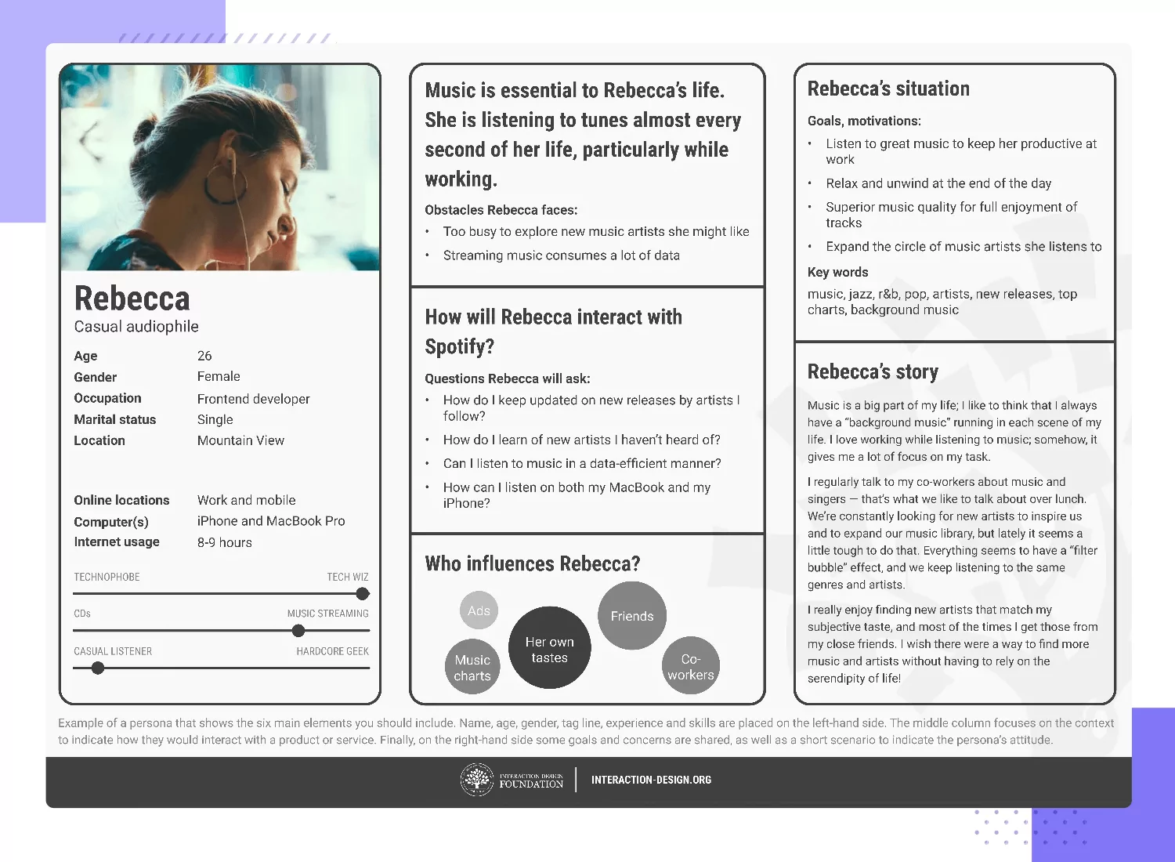

Slide 10
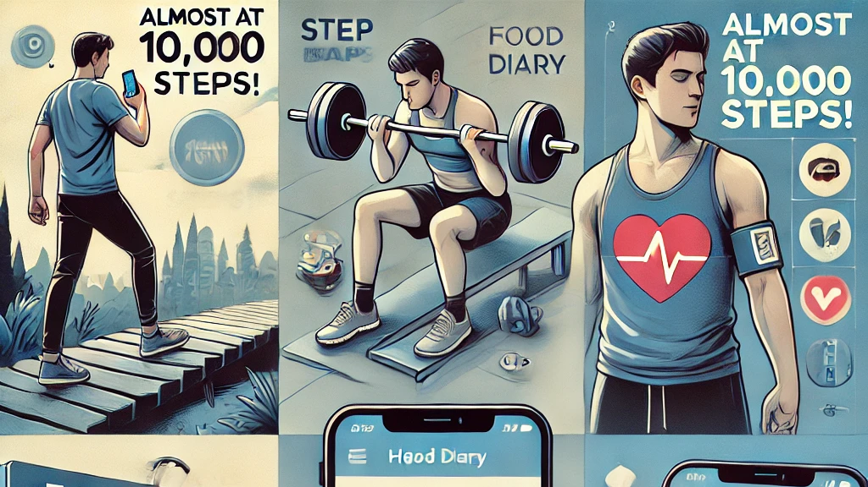

Slide 11
using scenarios throughout design
In Human-Computer Interaction (HCI) and User-Centered Design, scenarios play a critical role throughout the design process. By creating and employing scenarios, designers can better understand users' needs, contexts, and potential interactions with a system. Here's how scenarios are used across various design stages:
Problem identification and user research.
Requirements Gathering.
Conceptual Design and Prototyping(During the conceptual design phase, scenarios guide the creation of wireframes, flowcharts, and prototypes by outlining the user journey)
Interaction and Interface Design.
Usability Testing(Scenarios are crucial for usability testing, as they provide test cases based on real user stories.)
Post launch evaluation.

Slide 12
Scenario-based UX design
Scenario-based UX design is an approach where user stories, often written as scenarios, drive the creation of the user experience. It focuses on contextual tasks users will complete using the product, allowing designers to craft experiences that align with users’ real-world needs, behaviors, and emotions.
Key Elements of Scenario-Based UX Design
Persona: Represents a fictional user with specific goals, behaviors, and needs.
Scenario: Describes a day or moment in the life of that persona and highlights the specific tasks they aim to accomplish using the product.
Task Analysis: Breaks down what the persona is trying to do into tasks the system should support.
Context of Use: Considers when, where, and how the product will be used, focusing on real-world situations.
User Goals: Outlines what the user wants to achieve and how the design will meet these objectives.

Slide 13
Benefits
User-Centered Design: Scenarios ensure that the design is focused on real user needs, making the experience relevant and valuable.
Task-Focused Solutions: By breaking down the user journey into tasks, designers can identify friction points and design specific solutions to remove them.
Context Awareness: Scenarios help designers account for the different environments, devices, and emotional states users may be in when interacting with the app.
Empathy: Designing based on scenarios helps create empathy for users by understanding their daily challenges, goals, and motivations.
By using scenario-based UX design, the health app can become a more intuitive, personalized, and enjoyable tool for Sarah to manage her health and well-being effectively.

Slide 14
